Slide 1
Netflix Case Study | DELTTAA
Chad Madding

Slide 2
DELTTAA Data
Data:
When media moved from analog to digital files that could be streamed to any screen, it created a continuous flow of metadata.
https://data-flair.training/blogs/data-science-at-netflix/

Slide 3
DELTTAA Enterprise
Netflix invested in a lot of algorithms to provide a flawless movie experience to its users. One of such algorithms is the recommendation system that is used by Netflix to provide suggestions to the users. A recommendation system understands the needs of the users and provides suggestions of the various cinematographic products.
https://data-flair.training/blogs/data-science-at-netflix/

Slide 4
DELTTAA Leadership
Reed Hastings
FOUNDER AND CEO
Reed received a MSCS in Artificial Intelligence from Stanford University in 1988.
Currently looking for:
Senior Data Scientist - Experimentation Methodology and Implementation
The culture of experimentation and data-informed decision making led by Science & Analytics lies at the heart of Netflix product Innovation, and allows us to continuously evolve and improve the Netflix experience for our members around the globe.
https://data-flair.training/blogs/data-science-at-netflix/

Slide 5
DELTTAA Targets
Recommendation System
A recommendation system is a platform that provides its users with various contents based on their preferences and likings. A recommendation system takes the information about the user as an input. This information can be in the form of the past usage of product or the ratings that were provided to the product. It then processes this information to predict how much the user would rate or prefer the product. A recommendation system makes use of a variety of machine learning algorithms.
1. Content-based recommendation systems
In a content-based recommendation system, the background knowledge of the products and customer information are taken into consideration. Based on the content that you have viewed on Netflix, it provides you with similar suggestions. For example, if you have watched a film that has a sci-fi genre, the content-based recommendation system will provide you with suggestions for similar films that have the same genre.
2. Collaborative filtering recommendation systems
Unlike the content based filtering that provided recommendations of similar products, Collaborative Filtering provides recommendations based on the similar profiles of its users. One key advantage of collaborative filtering is that it is independent of the product knowledge. Rather, it relies on the users with a basic assumption that what the users liked in the past will also like in the future. For example, if a person A watches crime, sci-fi and thriller genres and B watches sci-fi, thriller and action genres then A will also like action and B will like crime genre.
https://data-flair.training/blogs/data-science-at-netflix/

Slide 6
DELTTAA Technologies
Then they implemented a factorization model which is popularly known as Singular Value Decomposition (SVD) for providing an optimal dimensional embedding to its users. They also made use of Restricted Boltzmann Machines (RBM) for enhancing the capability of the collaborative filtering model. These two algorithms in the ensemble, SVD and RBM provided them with the best results. A linear combination of these two algorithms reduced the RMSE to 0.88.
https://data-flair.training/blogs/data-science-at-netflix/

Slide 7
DELTTAA Analytical Techniques
Using Interleaving to Improve Personalization
Netflix uses Ranking Algorithms to provide a ranked list of movies and TV Shows that appeal the most to its users. However, with the presence of various ranking algorithms, it is often difficult to accommodate all of them and test their performance simultaneously. While the traditional A/B testing on a reduced set of algorithms could not identify the best algorithms with smaller sample size and also consumed a lot of time, Netflix decided to innovate its algorithmic process. In order to speed up its experimentation process of its ranking algorithms, Netflix implemented the interleaving technique that allowed it to identify best algorithms. This technique is applied in two stages to provide the best page ranking algorithm to provide personalized recommendations to its users.
In the first stage, experimentations to determine the member preference between the two ranking algorithms is carried out. Unlike the A/B testing where the two groups of viewers are exposed to the two ranking algorithms, Netflix makes use of interleaving to blend the rankings of algorithm A and B. Netflix provides its users with enriched content based on this interleaving technique that is highly sensitive towards ranking the algorithm quality.
https://data-flair.training/blogs/data-science-at-netflix/

Slide 8
DELTTAA Analysts
For performing contextual predictions, Netflix treats recommendations as a sequence classification problem. It takes the input as a sequence of user-actions and performs predictions that output the next set of actions. An example of a sequence problem is Gru4Rec. And in the case of contextual sequence prediction, the input consists of the contextual user actions as well as the current context of the user. This helps the recommendation engine solve the question:
“Based on all the historical actions that are taken by the user what is the most probable video that they will play right now?”
https://data-flair.training/blogs/data-science-at-netflix/

Slide 9
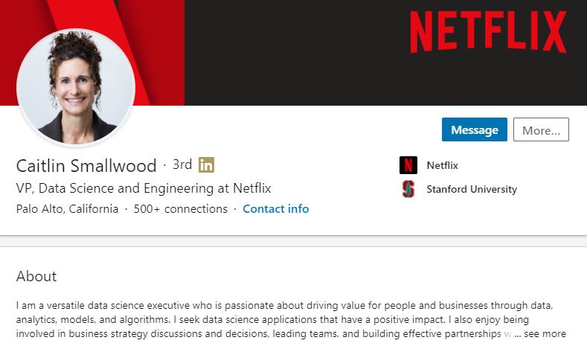

DELTTAA Analysts

Slide 10
Netflix Case Study | FACE
Chad Madding

Slide 11
FACE
Framing the problem
Problem recognition
Review of previous findings
Modeling approach
Solving the problem
Data collection
Modeling
Data analysis
Communicating and acting on results
Results presentation and action, i.e., “telling a story”
Creating impactful visualization
Embedding final models and methods in enterprise business processes and systems

Slide 12
FACE
Framing the problem
Problem recognition
How Netflix Used Data Science to Improve its Recommendation System?
Do you remember the last movie you watched on Netflix? I don’t want to know the name; just think about it- after watching the movie, were you recommended of similar movies? How does Netflix know what you’d like? The secret here is Data Science. Netflix uses Data Science to cater relevant and interesting recommendations to you. So, today, in this article, we will discuss the same. Let’s start exploring Data Science at Netflix with a basic introduction to Netflix.
https://data-flair.training/blogs/data-science-at-netflix/

Slide 13
FACE
Framing the problem
Problem recognition:
Review of previous findings
Netflix initially started as a DVD rental service in 1998. It mostly relied on a third party postal services to deliver its DVDs to the users. This resulted in heavy losses which they soon mitigated with the introduction of their online streaming service in 2007. In order to make this happen, Netflix invested in a lot of algorithms to provide a flawless movie experience to its users. One of such algorithms is the recommendation system that is used by Netflix to provide suggestions to the users. A recommendation system understands the needs of the users and provides suggestions of the various cinematographic products.
https://data-flair.training/blogs/data-science-at-netflix/

Slide 14
FACE
Solving the problem
Data collection
Executives used big data analytics to inform all of the most important decisions.
When media moved from analog to digital files that could be streamed to any screen, it created a continuous flow of metadata.
https://data-flair.training/blogs/data-science-at-netflix/

Slide 15
FACE
Solving the problem
Data collection
Modeling
A recommendation system is a platform that provides its users with various contents based on their preferences and likings. A recommendation system takes the information about the user as an input. This information can be in the form of the past usage of product or the ratings that were provided to the product. It then processes this information to predict how much the user would rate or prefer the product. A recommendation system makes use of a variety of machine learning algorithms.
https://data-flair.training/blogs/data-science-at-netflix/

Slide 16
FACE
Solving the problem
Data collection
Modeling
Data analysis
Another important role that a recommendation system plays today is to search for similarity between different products. In the case of Netflix, the recommendation system searches for movies that are similar to the ones you have watched or have liked previously. This is an important method for scenarios that involve cold start. In cold start, the company does not have much of the user data available to generate recommendations. Therefore, based on the movies that are watched, Netflix provides recommendations of the films that share a degree of similarity.
https://data-flair.training/blogs/data-science-at-netflix/

Slide 17
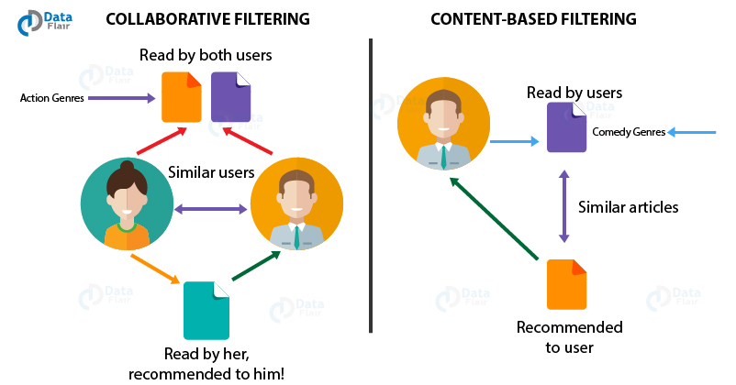
FACE
Communicating and acting on results
Results presentation and action, i.e., “telling a story”
Creating impactful visualization
https://data-flair.training/blogs/data-science-at-netflix/

Slide 18
FACE
Embedding final models and methods in enterprise business processes and systems
Netflix bases its data on various parameters like Day, Week, Season and even longer periods like Olympics, FIFA, and elections.
For performing contextual predictions, Netflix treats recommendations as a sequence classification problem. It takes the input as a sequence of user-actions and performs predictions that output the next set of actions. An example of a sequence problem is Gru4Rec. And in the case of contextual sequence prediction, the input consists of the contextual user actions as well as the current context of the user. This helps the recommendation engine solve the question:
“Based on all the historical actions that are taken by the user what is the most probable video that they will play right now?”
Executives used big data analytics to inform all of the most important decisions.
https://data-flair.training/blogs/data-science-at-netflix/

Slide 19
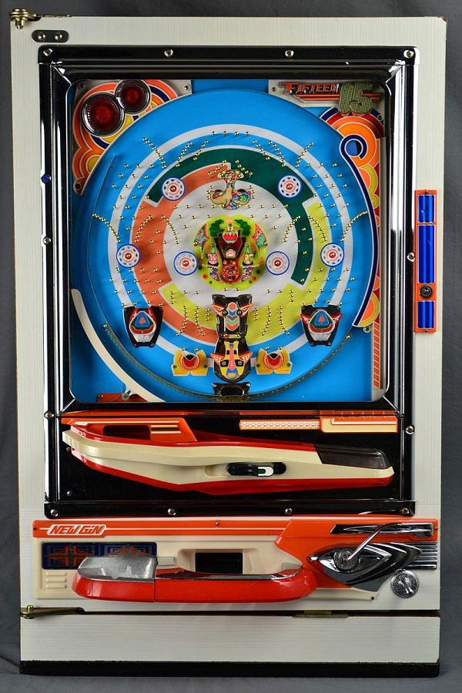
FACE: The Pachinko Machine!

Slide 20
Frame and Solve:
Analytics Solution Approach
Decision
What will you watch next? This is an ongoing decision.
One time or ongoing?
Predictive
Netflix can show you what it predicts you will watch next ?
Prescriptive
What does Netflix prescribe to show you what you will watch?
Stochastic
At the end of the day Netflx is forecasting/predicting what you will watch next.
Probabilistic statistical
Clustering, logistic regression, LDA, RF are all possible stochastic/statistical models to employ to estimate the probability of what you will watch next.
Clustering, logistic regression, LDA, RF are all possible stochastic/statistical models to employ to estimate the probability of what you will watch next.
R, SAS,
SPSS,Python

Slide 21
Questions 3 and 4 for Netflix
3. Are there any ethical or legal issues to consider?
The one thing that should always be addressed is that does the user know this data is being collected and do they agree with this.
4. Research the skills required / in demand of a data scientist at Netflix.
Senior Data Scientist – Globalization
At Netflix, we are revolutionizing storytelling by connecting our members around the world to an amazingly diverse set of international stories. Effective translation and cultural adaptation of our content and user interface play a critical role in building these connections. We are looking for a talented data scientist to partner with a world-class team of localization experts in order to unleash the power of data to transcend language barriers, and bring joy to over 150 million members across 190 countries.
Senior Data Scientist - Growth Experimentation and Modeling
At the heart of Netflix Product Innovations is an experimentation driven culture led by Data Science Data Science & Engineering. To drive greater growth, we are continually innovating across the acquisition funnel from creating new entry points and experiences for non-members, to the signup flow and pricing, through onboarding of new members. We are seeking a talented and creative data scientist to help optimize the Netflix acquisition experience. This is a high-impact position where you will guide product strategy through experimentation (A/B, quasi) and empirical studies. Your statistical modeling, analysis and interpretation of results inform decisions affecting millions of users, with a direct tie to Netflix revenue.

Slide 22
Union Pacific Case Study | DELTTAA
Chad Madding

Slide 23
DELTTAA Data
Data:
Top causes of rail equipment incidents
Subdivision (a specific section of track) Sensitivity Studies
Derailment after an incident
20 million data points collected at more than 4,700 special detectors deployed across our network
Union Pacific collects data from past incidents, ongoing track maintenance, road bed conditions, track materials and physical wear
https://www.up.com/aboutup/community/inside_track/predictive-analytics-09-18-2018.htm

Slide 24
DELTTAA Enterprise
Union Pacific's rail equipment incident rate in 2017 improved nearly 3 percent from 2016. We know there is room for more improvement. Innovative technology can enhance safety, and we remain focused on improving processes and investing in new technologies to keep our employees and our communities safe.
https://www.up.com/aboutup/community/inside_track/predictive-analytics-09-18-2018.htm

Slide 25
DELTTAA Leadership
John I.
John has a account
Data Scientist at Union Pacific Railroad
Currently looking for:
Senior Data Scientist - Experimentation Methodology and Implementation
The culture of experimentation and data-informed decision making led by Science & Analytics lies at the heart of Netflix product Innovation, and allows us to continuously evolve and improve the Netflix experience for our members around the globe.
“Although we still rely on lots of vendors, we tend to lean toward developing technologies in house,” says Lynden Tennison, UP’s senior vice president and chief information officer.
https://www.up.com/aboutup/community/inside_track/predictive-analytics-09-18-2018.htm

Slide 26
DELTTAA Targets
These technologies include:
Big Data Variability Analysis. We analyze top causes of rail equipment incidents and identify where and when to focus efforts to reduce them.
Subdivision (a specific section of track) Sensitivity Studies. Sensitivity studies identify the risk of incident through computer modeling. These models pinpoint worst-case scenarios within identified subdivisions where exposure may be the greatest if an incident occurred. We use this data to enact countermeasures that proactively address risk.
Post-Derailment Simulations. The use of computer modeling allows us to further define the cause of A derailment after an incident and fully understand what occurred to prevent future events.
Distributed Power Units. These locomotives operate in the middle and/or end of trains instead of only at the front. This placement makes trains less prone to derailments and facilitates more even braking that, in turn, reduces wheel and track wear. This technology also improves fuel efficiency, resulting in fewer emissions.
Ultrasonic Wheel-Defect Detection. Our robotic system scans each wheel in our coal-car fleet every 60 to 90 days to eliminate derailments caused by broken wheels.
Wayside Detectors. Our systems analyze daily 20 million data points collected at more than 4,700 special detectors deployed across our network. This helps us more accurately identify and repair potential failures in rail equipment components. We continue to maintain, install and improve our wayside technology infrastructure. For wheel impacts, this translates to further definition of our defect thresholds. It also helps us improve our wayside detection network coverage based on changes in our traffic volume, ensuring we have the right detector(s) at the right place at the right time.
Hot Bearing (“Hotbox”) Detectors. These detectors use infrared sensors to measure the temperature of bearings as a train rolls by allowing us to identify faulty bearings that could result in a derailment.
Acoustic Bearing Detectors. Sound plays a role in determining the safety of bearings. Acoustic bearing detectors feature a shutter that opens just prior to the passing of a train. The open shutter allows an array of microphones to identify bearing defects.
Wheel Profile Detectors. The wheel profile detector uses a laser similar to a supermarket checkout scanner to capture a crosssectional snapshot of the outline of a wheel as it rolls by. Based on this data, wheel defects are identified, reported and addressed.
https://www.up.com/aboutup/community/safety/technology/index.htm

Slide 27
DELTTAA Technologies
Created by a cross-functional team of engineering, information technology, operations and safety experts, the new model is the result of decades of investments in data collection technologies installed in track, trucks and on right-of-ways.
Union Pacific Associate Systems Engineer Nina Lahvinovich assembled and tested the numerous data elements using a tool called a logistic regression model, a highly sophisticated probability method used to predict what will happen based on what’s already happened.
https://www.up.com/aboutup/community/inside_track/predictive-analytics-09-18-2018.htm

Slide 28
DELTTAA Analytical Techniques
logistic regression model
As the model increased in accuracy, the team began testing it in the field.
“This model will never replace human senses or the vast knowledge base residing in the people we’ve trained for decades,” said Ed Adelman, Union Pacific general director of safety.
But Adelman says in most cases, there isn’t one single cause of track failures. It’s a bunch of little things that add up over time.
https://www.up.com/aboutup/community/inside_track/predictive-analytics-09-18-2018.htm

Slide 29
DELTTAA Analysts
“The model looks at thousands of variables that make a piece of track stand out long before a failure occurs,” he said. “Humans can’t assemble this much data and objectively use it to predict future track failure as quickly as these tools can. The data load is just too much to process for every mile of track, so the model does it for them.”
https://www.up.com/aboutup/community/inside_track/predictive-analytics-09-18-2018.htm

Slide 30
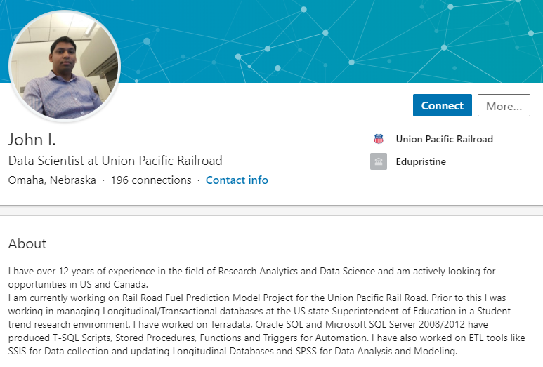
DELTTAA Analysts

Slide 31
Union Pacific Case Study | FACE
Chad Madding

Slide 32
FACE
Framing the problem
Problem recognition
Review of previous findings
Modeling approach
Solving the problem
Data collection
Modeling
Data analysis
Communicating and acting on results
Results presentation and action, i.e., “telling a story”
Creating impactful visualization
Embedding final models and methods in enterprise business processes and systems

Slide 33
FACE
Framing the problem
Problem recognition
Derailment
Wheel-Defect
Failures in rail equipment
Hot Bearing
https://www.up.com/aboutup/community/inside_track/predictive-analytics-09-18-2018.htm

Slide 34
FACE
Framing the problem
Problem recognition:
Review of previous findings
Broken rails are the leading cause of train derailments in the U.S., according to the Federal Railroad Administration. Daniel Torres, Union Pacific director of rail management, works hard to upgrade Union Pacific’s infrastructure before defects occur.
https://www.up.com/aboutup/community/inside_track/predictive-analytics-09-18-2018.htm

Slide 35
FACE
Solving the problem
Data collection
Union Pacific collects data from past incidents, ongoing track maintenance, road bed conditions, track materials and physical wear.
https://www.up.com/aboutup/community/inside_track/predictive-analytics-09-18-2018.htm

Slide 36
FACE
Solving the problem
Data collection
Modeling
Union Pacific’s decision analytics, engineering and safety teams have been working to create a predictive analytics model to generate a list of the most at-risk track sections, mile-by-mile.
https://www.up.com/aboutup/community/inside_track/predictive-analytics-09-18-2018.htm

Slide 37
FACE
Solving the problem
Data collection
Modeling
Data analysis
“We already have a lot of important standard systems that guide us in the right direction,” Torres said. “But this model looks at rail in a different way. It tells me which elements are creating risk long before something goes wrong. It enables us to be more strategic in our infrastructure investment decisions.”
Created by a cross-functional team of engineering, information technology, operations and safety experts, the new model is the result of decades of investments in data collection technologies installed in track, trucks and on right-of-ways.
https://www.up.com/aboutup/community/inside_track/predictive-analytics-09-18-2018.htm

Slide 38
FACE
Communicating and acting on results
“The model alone can’t replace the human element of knowing and maintaining our railroad,” Adelman said. “You can’t decouple this from all the other things we do to detect track defects, it’s all important. But you can ease employee workload by using these tools to assess risk.”
Torres is certain this model is a sign of epic safety advancements to come.
https://www.up.com/aboutup/community/inside_track/predictive-analytics-09-18-2018.htm

Slide 39
FACE
Embedding final models and methods in enterprise business processes and systems
“We’ll continue to get more precise,” he said. “We’ll keep dissecting our network, and working hard to understand its behavior. We just started working on a predictive model for track bed, I’m sure there will be another after that, and eventually they’ll start to learn from each other. We’re living in a new world of information, and it will continue to expand.”
https://www.up.com/aboutup/community/inside_track/predictive-analytics-09-18-2018.htm

Slide 40
FACE: The Pachinko Machine!

Slide 41
Frame and Solve:
Analytics Solution Approach
Decision
What rails could break next? This is an ongoing decision.
One time or ongoing?
Predictive
Union Pacific can predict what rails could break next?
Prescriptive
What does Union Pacific prescribe to show you what could go wrong in their system next?
Stochastic
At the end of the day Union Pacific is forecasting/predicting what could break next in their system.
Probabilistic statistical
Clustering, logistic regression, LDA, RF are all possible stochastic/statistical models to employ to estimate the probability of what could breakdown next.
Clustering, logistic regression, LDA, RF are all possible stochastic/statistical models to employ to estimate the probability of what could breakdown next.
R, SAS,
SPSS,Python

Slide 42
Questions from the Union Pacific study:
Are there any ethical or legal issues to consider?
In regards to what Union Pacific is doing with their data. The one thing that might need to be addressed about ethics is their use of personal employee data. The video pointed out that they were tracking things like before and after holidays and time off. This just might need to be noted and addressed.
Takeaway questions:
I have no takeaway questions at this time.

